Slide 1

Projek Fundamental Golang
“Infak PUB”
Oleh : Putri Lestari (S1 Akuntansi)

Slide 2

Infak PUB??
Program ini adalah program sederhana yang digunakan untuk menginput data infak pub, dibuat dengan tujuan memudahkan tugas bendahara khusunya bendahara eksternal.

Slide 3
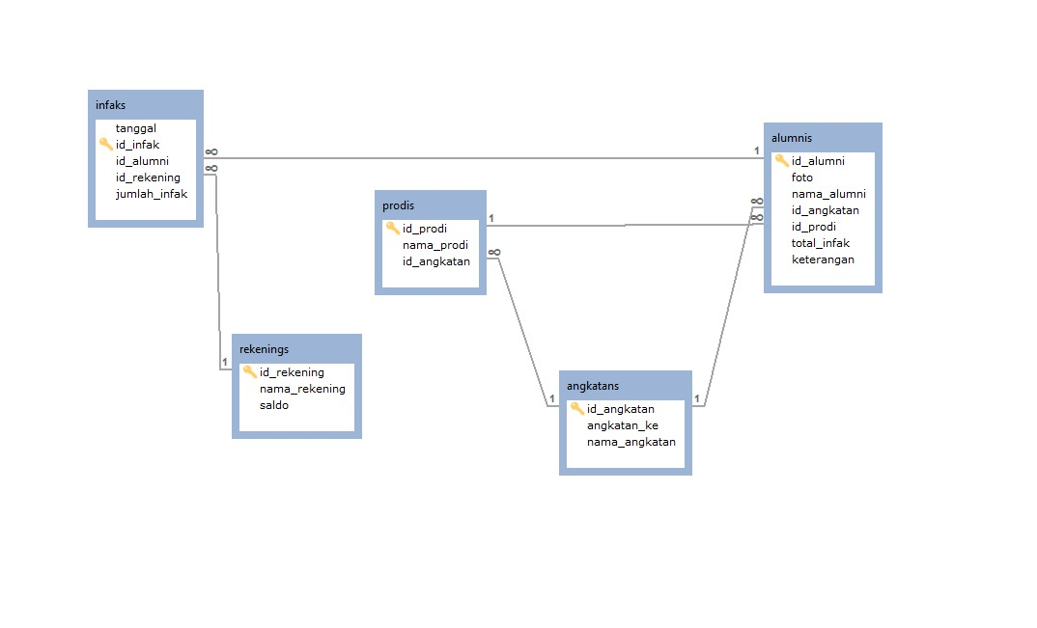
Relasi Tabel
Angkatan
Prodi
Alumni
Infak

Slide 4
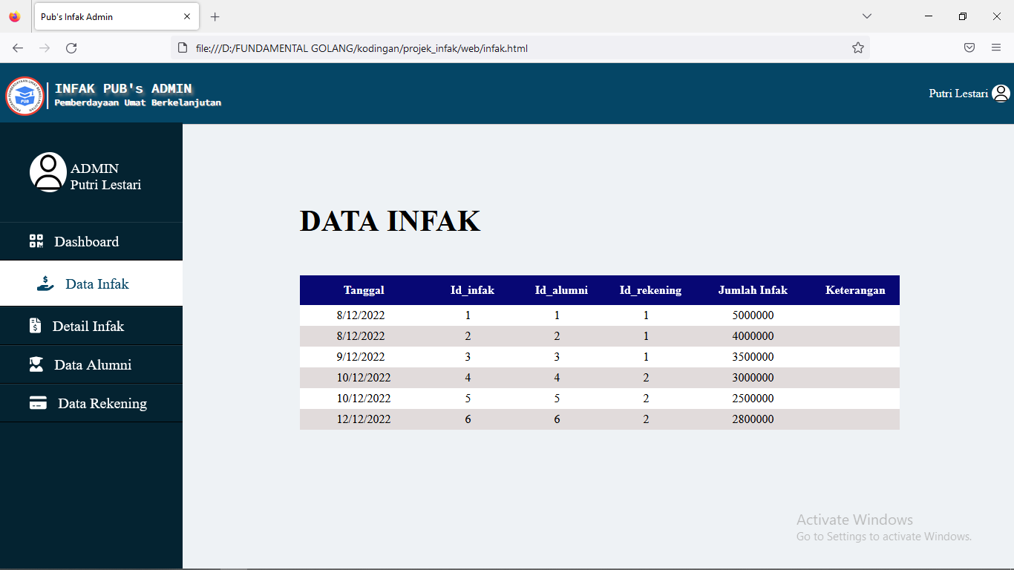
Data Infak
Here’s what you’ll find in this Slidesgo template:
A slide structure based on a presentation for education, which you can easily adapt to your needs. For more info on how to edit the template, please visit Slidesgo School or read our FAQs.
An assortment of graphic resources that are suitable for use in the presentation can be found in the alternative resources slide.
A thanks slide, which you must keep so that proper credits for our design are given.
A resources slide, where you’ll find links to all the elements used in the template.
Instructions for use.
Final slides with:
The fonts and colors used in the template.
A selection of illustrations. You can also customize and animate them as you wish with the online editor. Visit Storyset to find more.
More infographic resources, whose size and color can be edited.
Sets of customizable icons of the following themes: general, business, avatar, creative process, education, help & support, medical, nature, performing arts, SEO & marketing, and teamwork.
You can delete this slide when you’re done editing the presentation.

Slide 5
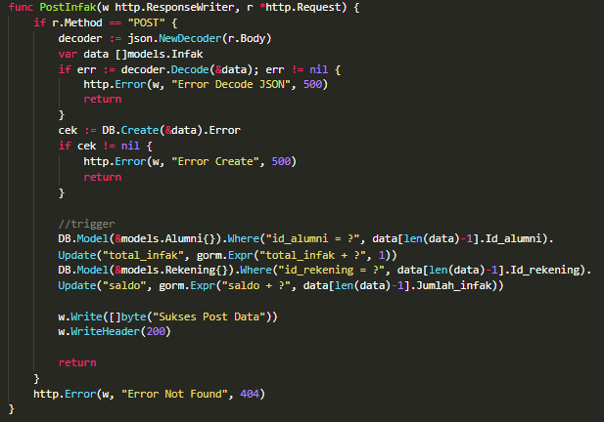
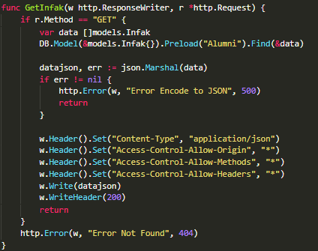
Controller data Infak
Trigger after post

Slide 6
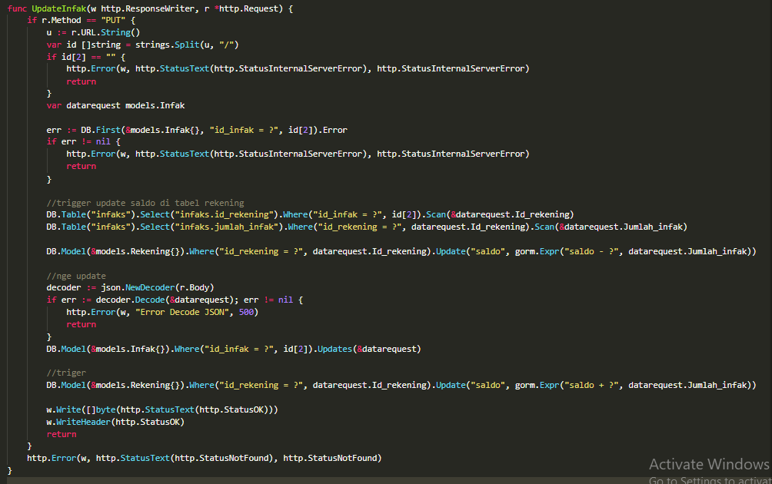
Controller Data Infak
Trigger after update
Them
Us
Mercury is the closest planet to the Sun and the smallest one in the Solar System—it’s only a bit larger than the Moon
Venus has a beautiful name and is the second planet from the Sun. It’s hot and has a poisonous atmosphere
Trigger after update

Slide 7
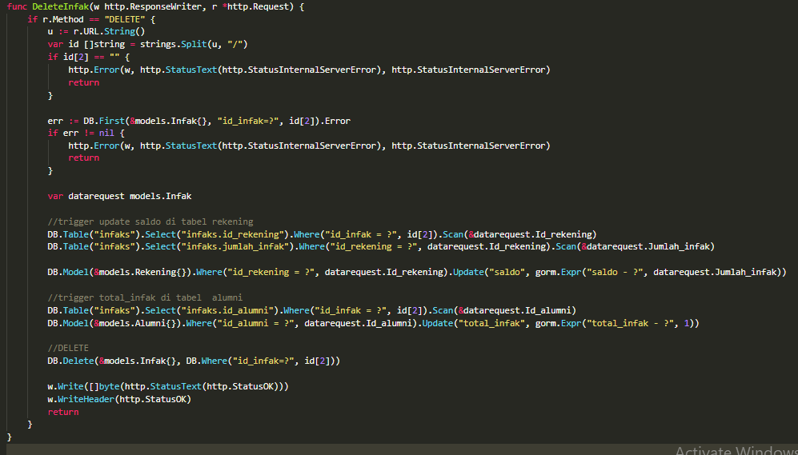
Controller Data Infak
TRIGGER (Mengurangi saldo di table rekening)
Them
Us
Mercury is the closest planet to the Sun and the smallest one in the Solar System—it’s only a bit larger than the Moon
Venus has a beautiful name and is the second planet from the Sun. It’s hot and has a poisonous atmosphere
TRIGGER (Mengurangi total_infak di table alumni)

Slide 8
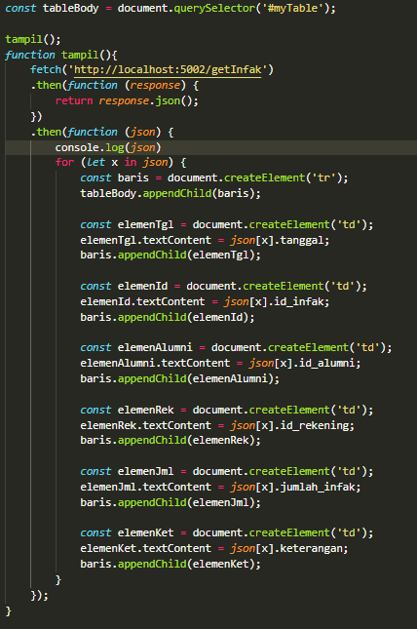
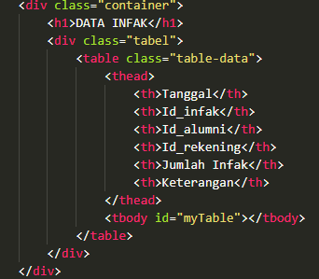
Menghubungkan data ke front end

Slide 9
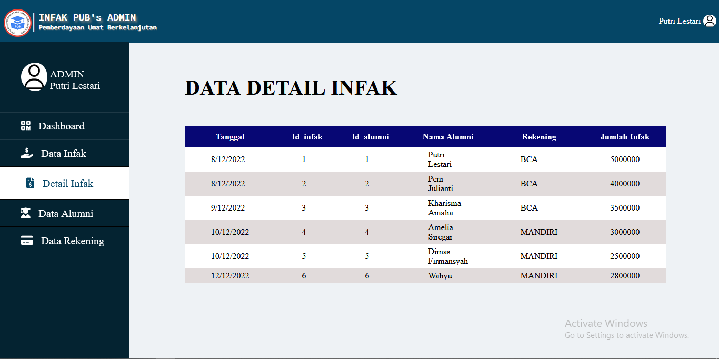
Data Detail Infak
Here’s what you’ll find in this Slidesgo template:
A slide structure based on a presentation for education, which you can easily adapt to your needs. For more info on how to edit the template, please visit Slidesgo School or read our FAQs.
An assortment of graphic resources that are suitable for use in the presentation can be found in the alternative resources slide.
A thanks slide, which you must keep so that proper credits for our design are given.
A resources slide, where you’ll find links to all the elements used in the template.
Instructions for use.
Final slides with:
The fonts and colors used in the template.
A selection of illustrations. You can also customize and animate them as you wish with the online editor. Visit Storyset to find more.
More infographic resources, whose size and color can be edited.
Sets of customizable icons of the following themes: general, business, avatar, creative process, education, help & support, medical, nature, performing arts, SEO & marketing, and teamwork.
You can delete this slide when you’re done editing the presentation.

Slide 10
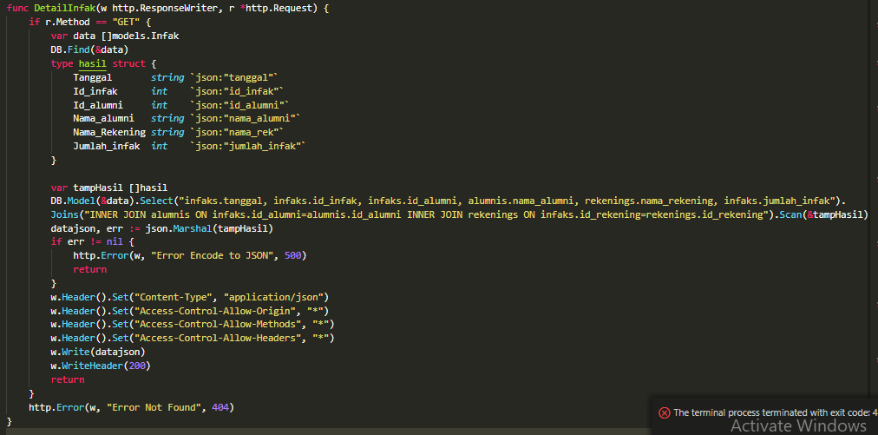
Controller Detail Infak
JOIN (infaks, alumnis, rekenings)

Slide 11
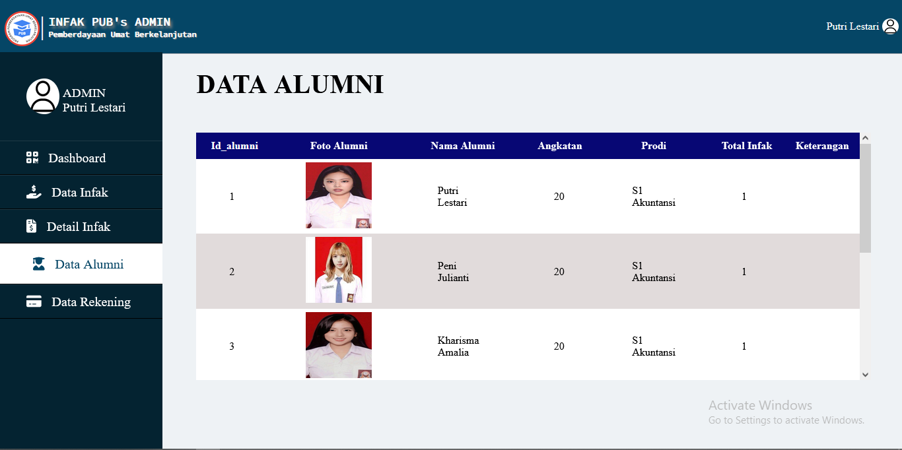
Data Alumni
Here’s what you’ll find in this Slidesgo template:
A slide structure based on a presentation for education, which you can easily adapt to your needs. For more info on how to edit the template, please visit Slidesgo School or read our FAQs.
An assortment of graphic resources that are suitable for use in the presentation can be found in the alternative resources slide.
A thanks slide, which you must keep so that proper credits for our design are given.
A resources slide, where you’ll find links to all the elements used in the template.
Instructions for use.
Final slides with:
The fonts and colors used in the template.
A selection of illustrations. You can also customize and animate them as you wish with the online editor. Visit Storyset to find more.
More infographic resources, whose size and color can be edited.
Sets of customizable icons of the following themes: general, business, avatar, creative process, education, help & support, medical, nature, performing arts, SEO & marketing, and teamwork.
You can delete this slide when you’re done editing the presentation.

Slide 12
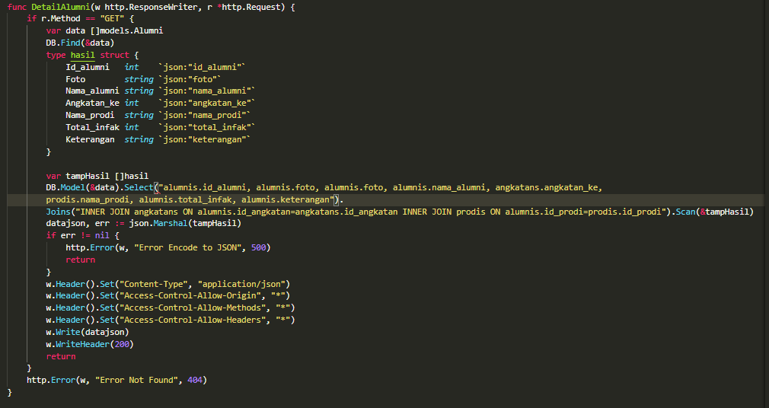
Data Detail Alumni
Here’s what you’ll find in this Slidesgo template:
A slide structure based on a presentation for education, which you can easily adapt to your needs. For more info on how to edit the template, please visit Slidesgo School or read our FAQs.
An assortment of graphic resources that are suitable for use in the presentation can be found in the alternative resources slide.
A thanks slide, which you must keep so that proper credits for our design are given.
A resources slide, where you’ll find links to all the elements used in the template.
Instructions for use.
Final slides with:
The fonts and colors used in the template.
A selection of illustrations. You can also customize and animate them as you wish with the online editor. Visit Storyset to find more.
More infographic resources, whose size and color can be edited.
Sets of customizable icons of the following themes: general, business, avatar, creative process, education, help & support, medical, nature, performing arts, SEO & marketing, and teamwork.
You can delete this slide when you’re done editing the presentation.
JOIN (alumnis, angkatans, prodis)

Slide 13
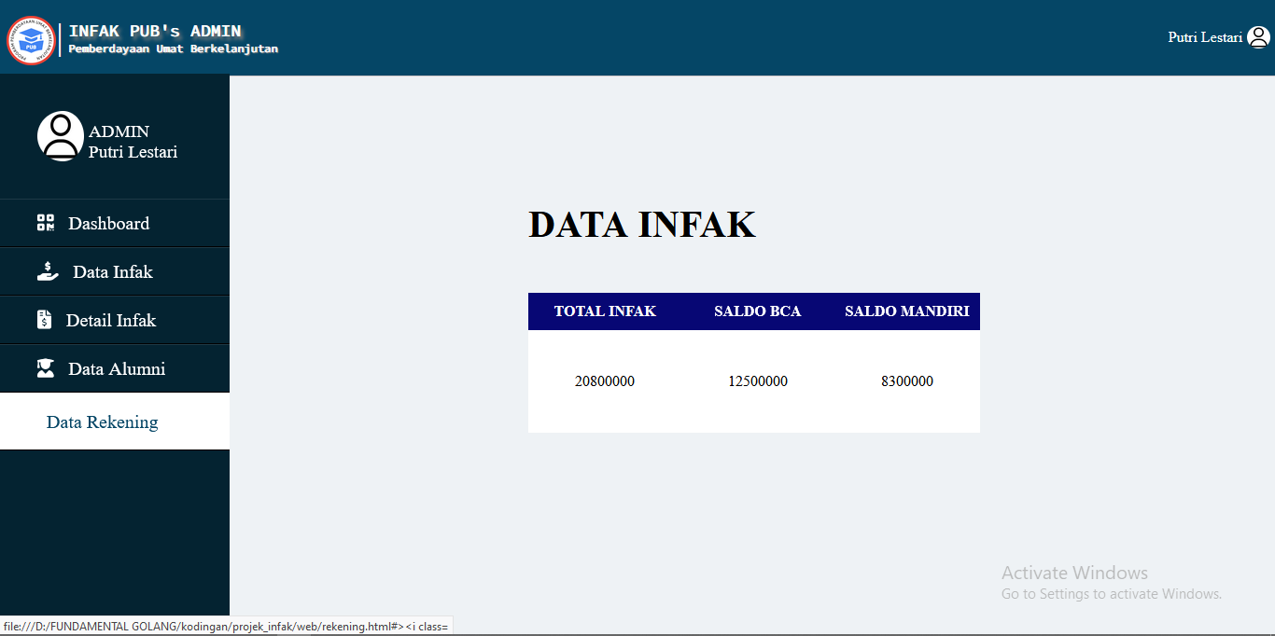
Data Total Infak
Here’s what you’ll find in this Slidesgo template:
A slide structure based on a presentation for education, which you can easily adapt to your needs. For more info on how to edit the template, please visit Slidesgo School or read our FAQs.
An assortment of graphic resources that are suitable for use in the presentation can be found in the alternative resources slide.
A thanks slide, which you must keep so that proper credits for our design are given.
A resources slide, where you’ll find links to all the elements used in the template.
Instructions for use.
Final slides with:
The fonts and colors used in the template.
A selection of illustrations. You can also customize and animate them as you wish with the online editor. Visit Storyset to find more.
More infographic resources, whose size and color can be edited.
Sets of customizable icons of the following themes: general, business, avatar, creative process, education, help & support, medical, nature, performing arts, SEO & marketing, and teamwork.
You can delete this slide when you’re done editing the presentation.

Slide 14
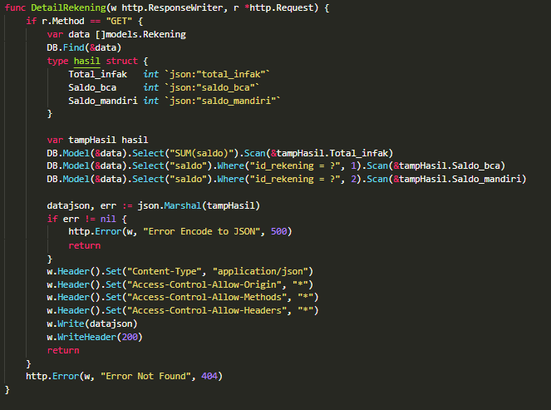
Total Infak
Here’s what you’ll find in this Slidesgo template:
A slide structure based on a presentation for education, which you can easily adapt to your needs. For more info on how to edit the template, please visit Slidesgo School or read our FAQs.
An assortment of graphic resources that are suitable for use in the presentation can be found in the alternative resources slide.
A thanks slide, which you must keep so that proper credits for our design are given.
A resources slide, where you’ll find links to all the elements used in the template.
Instructions for use.
Final slides with:
The fonts and colors used in the template.
A selection of illustrations. You can also customize and animate them as you wish with the online editor. Visit Storyset to find more.
More infographic resources, whose size and color can be edited.
Sets of customizable icons of the following themes: general, business, avatar, creative process, education, help & support, medical, nature, performing arts, SEO & marketing, and teamwork.
You can delete this slide when you’re done editing the presentation.
SUM
JOIN (alumnis, angkatans, prodis)

Slide 15
Thanks!
☺

